Slide 1

Credit / Home Loans
Presented by: Theresa Ofili
Last Updated: 3rd November 2022

Slide 2
TEXT LAYOUT 1
Credit / Home Loans
Agenda
Data Science Lifecycle​
Business Understanding
Data Understanding
Data Preparation
Modelling
Model Evaluation
Recommendations

Slide 3
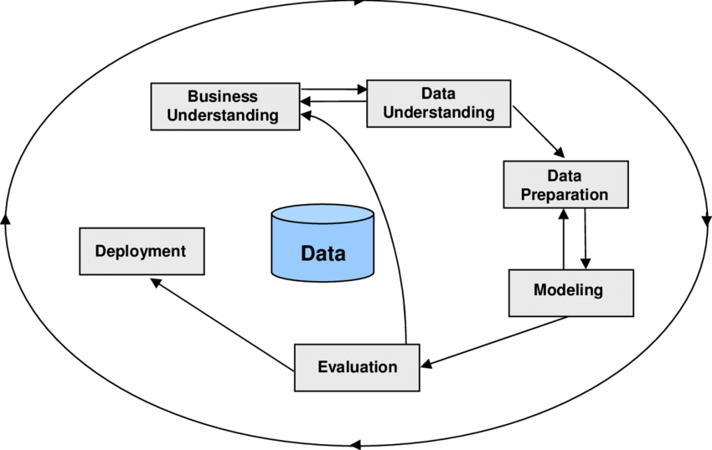
TEXT LAYOUT 1
Data Science Lifecycle
The data science lifecycle, CRISP-DM(Cross-Industry Standard Process for Data Mining) will be used to analyze the credit /home loan of a bank
CRISP-DM CHART

Slide 4

TEXT LAYOUT 1
Business Understanding
Problem: Slow response times to grant loans to potentially credible bank customers due to poorly defined assessment parameters
Objective: To build and deploy a model that quickly assesses an applicant’s credibility to enable fast decision-making regarding loan disbursements
Hypothesis: Defined applicant features would be important to quickly and sufficiently evaluate customer credibility

Slide 5
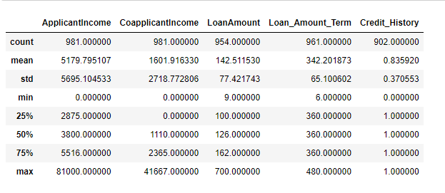
Data Understanding
Statistics of the data
Data Preparation
The data has thirteen(13) columns and nine hundred and eighty-one(981) rows.
The columns consists of several information about the applicant from income earned, loan applied to marriage status and dependent.
The data provided had lots of missing information

Slide 6
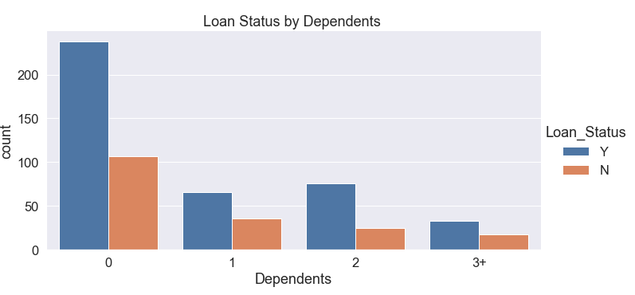
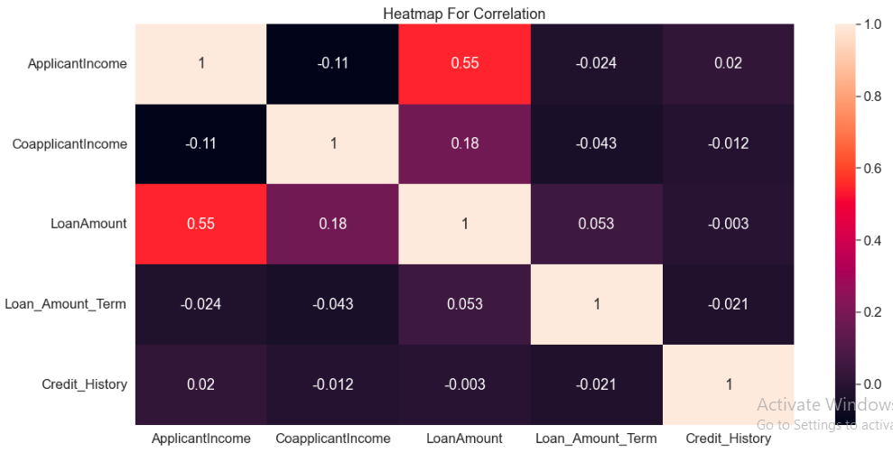
Data Preparation
Data Correlation
The applicant’s income has a positive correlation to the loan approved
Data Trend
The number of dependents has a significant effect on loan performance for applicants, as seen in the chart below

Slide 7
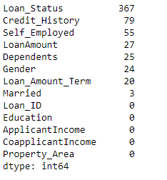
TEXT LAYOUT 1
Data Preparation
Data Cleaning
Number of Missing Data
The mean was used to fill in the missing values for numerical values, and the most common values for each column were used to fill in the gaps for categorical values.
The arrow denotes the numerical values with incomplete data, others are category values with missing data.

Slide 8
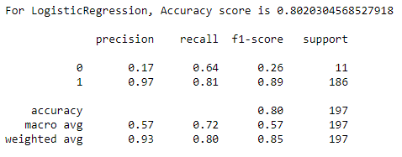
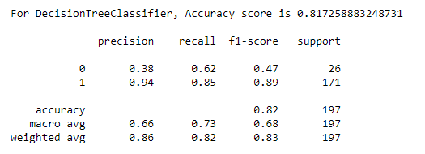
Modelling
After applying the train and tested data to the various models, decisiontreeclassifier and logistic regression have the highest accuracy score.

Slide 9
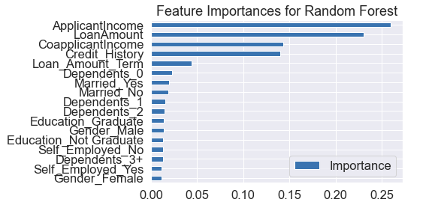
TEXT LAYOUT 1
Model Evaluation

Slide 10
Recommendations
When it comes to an applicant's loan credibility, the importance of the applicant and co-applicant income has been demonstrated to be at the top of the list..
Prior to loan distribution, the applicant's dependents must also be carefully taken into account.
From the process of using the CRISP-DM(Cross-Industry Standard Process for Data Mining), we were able to draw up a conclusion on the top five(5) features that can be used to evaluate an applicant’s credibility worthiness.

